Slide 1
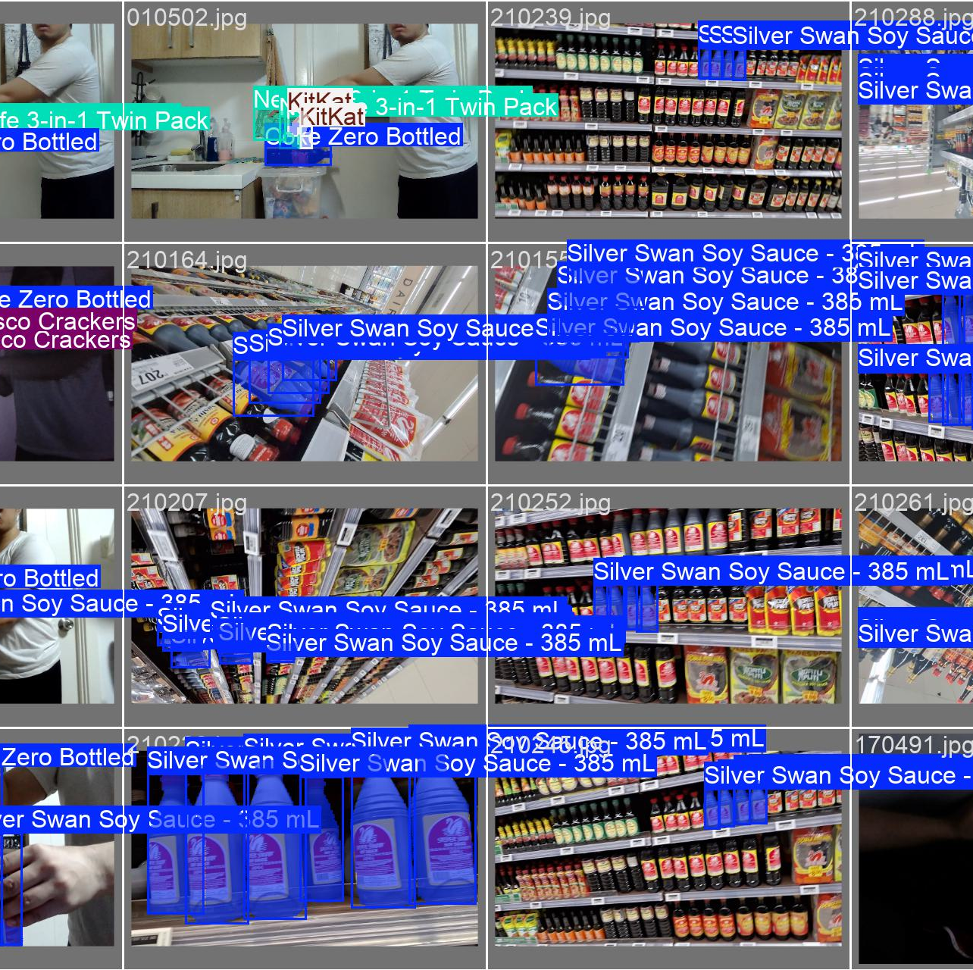
Machine Exercise 6 – Grocery Detection Miguel Luis Martinez
Uses YOLOv11 fine-tuned on grocery dataset
24 classes, 10233 (from 7604) train + 1132 (from 845) val in total
Includes low light and distant images
Added image augmentations to dataset (skew, flip, cutmix, etc)
Train over 500 epochs

Slide 2
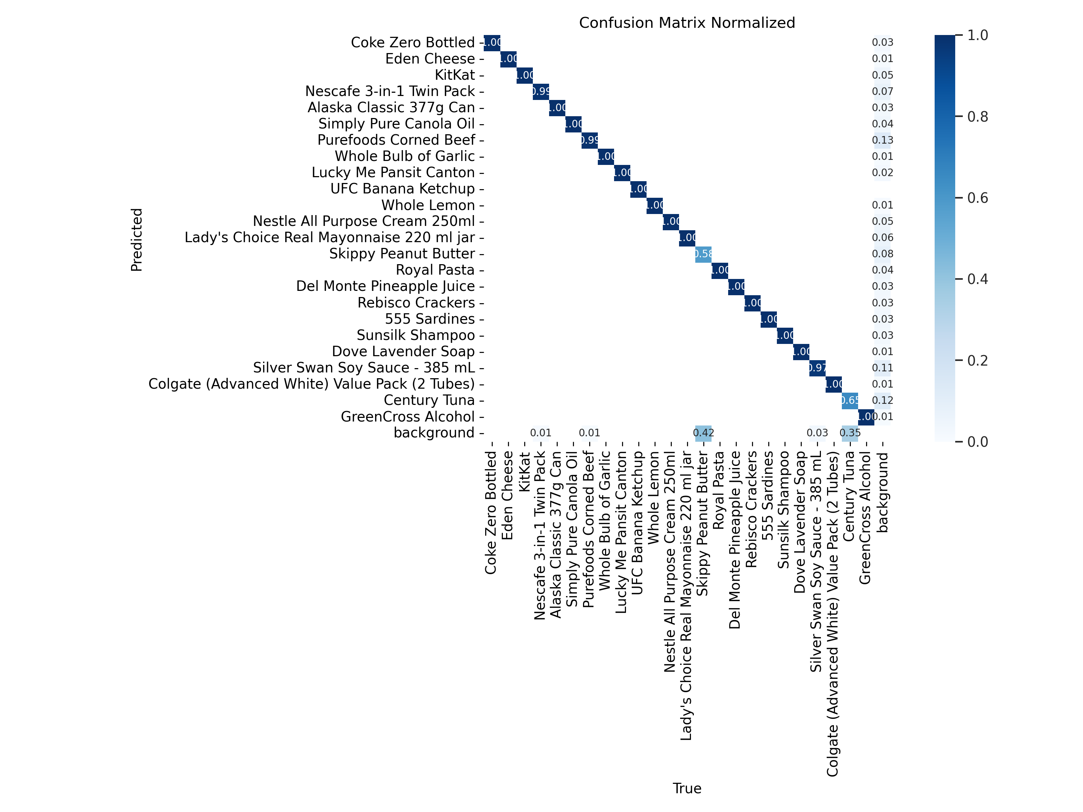
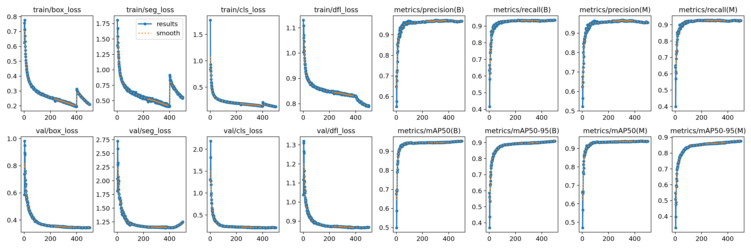
Training Results
Model | Epochs | Precision | Recall | mAP50 | mAP50-95
YOLO11 M Segment | 500 | 0.95386 | 0.92581 | 0.9384 | 0.8758
YOLO11 S Segment | 500 | 0.95634 | 0.9161 | 0.93181 | 0.84751
YOLO11 N Segment | 500 | 0.95788 | 0.92526 | 0.93911 | 0.87137
YOLO11 N Segment (Augmented) | 1000 | 0.93289 | 0.86921 | 0.90911 | 0.74957
YOLO11 M Segment (Augmented) | 300

Slide 3
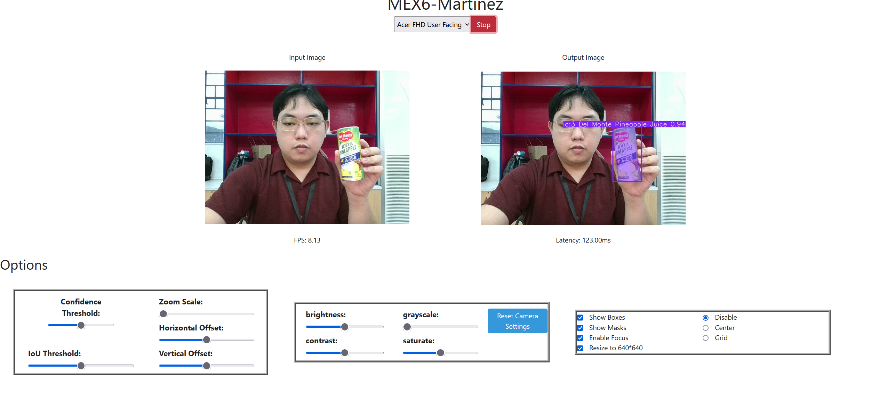
Application
Uses javascript + FastAPI for full server-side inference
Issues
Training regularly runs out of memory
Issues in transfer learning

